Slide 1

Python! Day 23
Work on the password manager program
Errors and exceptions
JSON data
Improve the password manager and NATO alphabet programs

Slide 2

Warm Up: Password Manager Extra Features
These are optional, but some extra features we can add to our program are:
Popup that prevents the user from leaving the website or password box empty
Code that copies the password to the clipboard when the user presses the generate password button using the pyperclip module
Google the pyperclip documentation to figure out how
Fix the UI layout spacing if it’s messed up

Slide 3
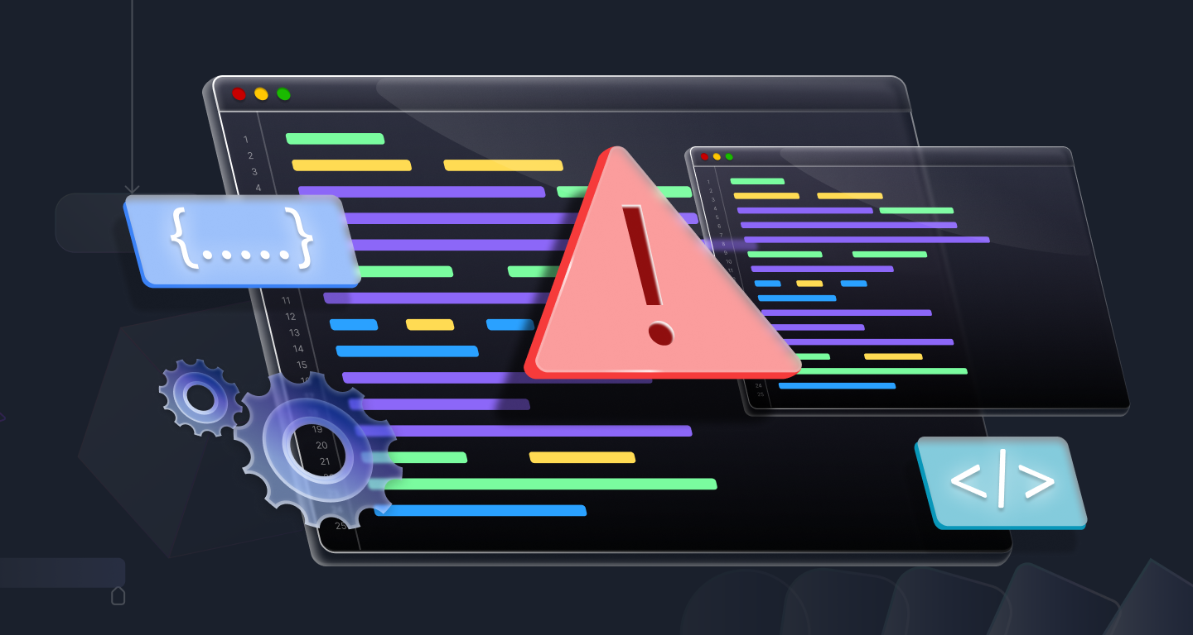
Errors
While we’ve been coding in Python, we’ve come across a lot of errors when our code doesn’t work
So far, we’ve been using errors as an indicator of when we’ve coded something incorrectly
Today, we’re going to learn how we can use errors and error messages inside our code
This is useful so if we have a program requiring user input and the user types something that causes an error, we don’t have the program immediately stop and display an error message, which might be confusing to non-programmers
Instead, when our program encounters an error with the user input, we can tell the user what the problem is and ask them to try again

Slide 4
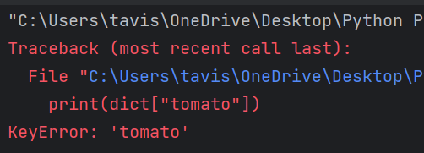
Types of Errors
Here are the common types of errors we’ve seen:
FileNotFoundError – Happens when we’re trying to read a file that doesn’t exist
file = open(“fake_file.txt”, “r”)
KeyError – Happens when we try to access the key of a dictionary that doesn’t exist
dict = {
“apple” : “fruit”,
“potato” : “vegetable”
}
var = dict[“tomato”]

Slide 5
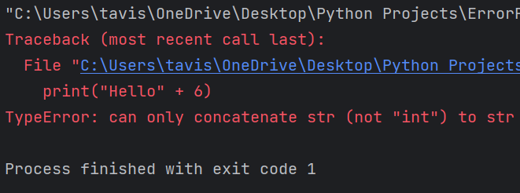
Types of Errors Continued
IndexError – Happens when we try to access an index of something like a list that doesn’t exist
list = [“apple”, “orange”]
fruit = list[9]
TypeError – Happens when we’re trying to do something with an incorrect data type
print(“Hello” + 6)

Slide 6

Exceptions
Writing exceptions allows the program to not immediately stop when it encounters a certain error and instead do something else
Exceptions follow this format:
try:
# piece of code that might cause an error
except:
# what the program should do if it runs into an error
else:
# what the program should do if it does not run into an error
finally:
# what the program should do afterward

Slide 7
Exception Example
Let’s write a program that takes a number input by the user and squares it
If the user inputs something that’s not a number, let’s ask them to try again
Our exception block will look something like this:
try:
num = int(input("Enter a number: "))
except ValueError:
print("Please enter a valid number")
else:
print("Your number squared is: " + str(num * num))

Slide 8
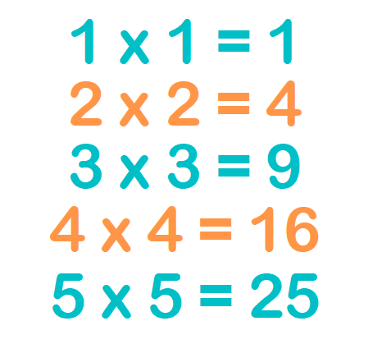
def square_number():
try:
num = int(input("Enter a number: "))
except ValueError:
print("Please enter a valid number")
square_number()
else:
print("Your number squared is: " + str(num * num))
square_number()
We need to add ValueError after except because otherwise, our code in the try area would ignore all errors instead of just the one we’re looking for

Slide 9
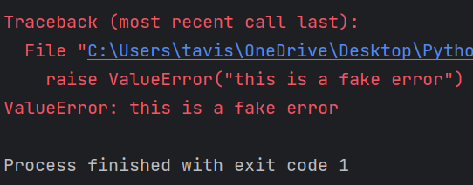
Raising Your Own Exceptions
We can also create our own exceptions using the raise keyword
For example, if we want to cause a TypeError with the error message “this is a fake error”, we will write this:
raise TypeError(“this is a fake error”)
A more realistic application of this would be if you’re getting the user’s height and they input a height of 300 ft, which isn’t a valid human height
In this case we could use a ValueError with a message stating that human height should not exceed 9 ft
Try it out

Slide 10

Challenge: Pie Creator
Let’s create a small program that takes a user order number and prints a pie flavor using the fruit at the user number’s index in a fruit list
For example, if fruit_list = [“apple”, “orange”, “banana”] and the user inputs 2, the program should print “banana pie”
If the user enters an invalid index, print “fruit pie”

Slide 11

fruits = ["apple", "orange", "banana", "kiwi", "pecan"]
pie_num = int(input("Enter your pie number: "))
try:
fruit = fruits[pie_num]
except IndexError:
print("fruit pie")
else:
print(fruit + " pie")

Slide 12

Challenge: Car Year Calculator
Let’s make a list of cars with dictionaries of the cars’ different attributes inside
Ex:
cars = [
{"years_old" : 5, "make" : "Honda", "color" : "red"},
{"years_old" : 20, "color" : "black"},
{"color" : "orange", "license_plate" : "KDW254"}
]
Now let’s use a for loop to add up all the years_old values of the cars
If the car doesn’t have a years_old value, add 0

Slide 13

cars = [
{"years_old" : 5, "make" : "Honda", "color" : "red"},
{"years_old" : 20, "color" : "black"},
{"color" : "orange", "license_plate" : "KDW254"}
]
years = 0
for car in cars:
try:
years += car["years_old"]
except KeyError:
pass
print(years)

Slide 14
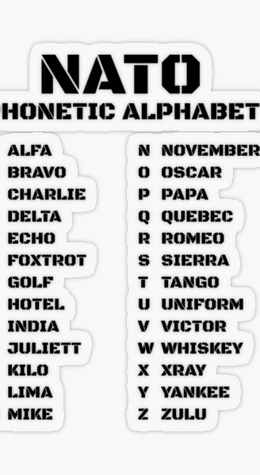
Improving the NATO Phonetic Alphabet
A while back, we made a NATO phonetic alphabet translator as part of our list comprehension day
Let’s use what we’ve learned about errors to improve that project
If the user enters an invalid word (like “124” or something“), let’s replace the error message with a print statement saying, “Please enter a valid word”
Then, let’s let the user re-enter a word
This change is useful so users don’t get a confusing error message that only makes sense to programmers, instead, they get a clear message through a print statement

Slide 15
alphabet = pd.read_csv("nato_phonetic_alphabet.csv")
dict = {row["letter"]:row["code"] for (index, row) in alphabet.iterrows()}
def translate_word():
word = input("Enter a word: ").upper()
try:
translated_word = [dict[letter] for letter in word]
except KeyError:
print("Please only enter letters from the English alphabet")
translate_word()
else:
print(translated_word)
translate_word()

Slide 16
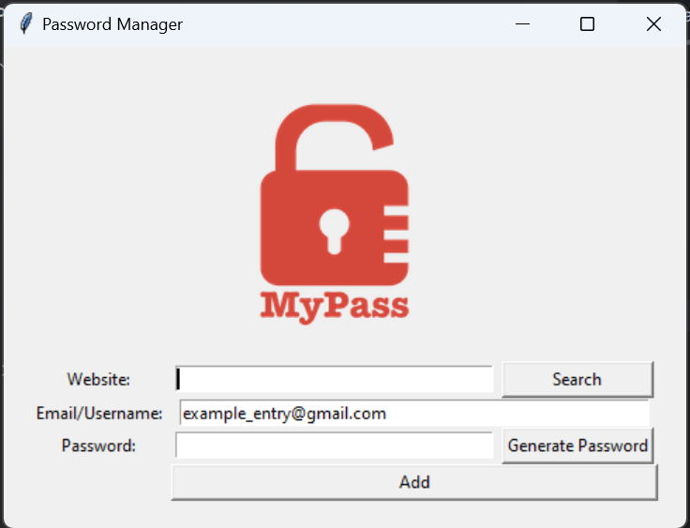
Project: Improve the Password Manager
Next, let’s open up our password manager so we can add a function to it
Let’s add a search button to our password manager so we can enter a website name, and the program will show us a pop-up with the corresponding email and password
Right now, if we were to try and do this, it would be really difficult because of the way we formatted out data.txt file
So first, let’s learn about a more convenient way to store our data using a json file

Slide 17
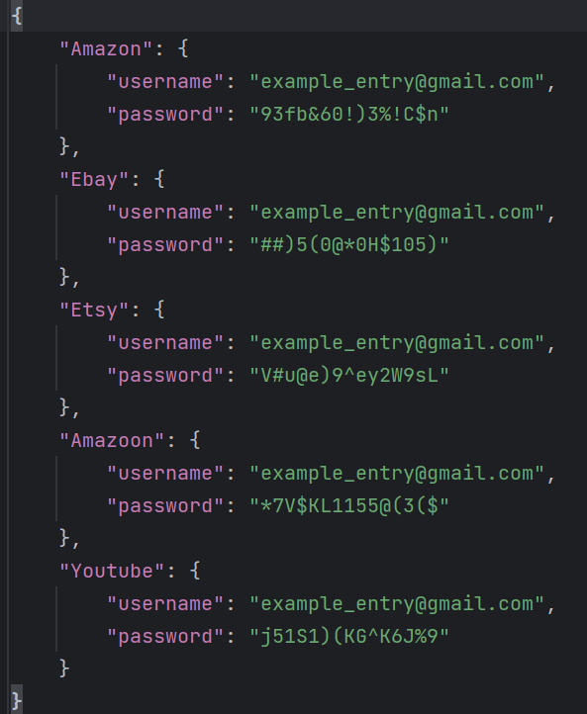
Json Files
Json files are essentially files that store data in a dictionary format
First, we’ll have to import json at the top of our project
Next, in our save() function, let’s change the file we’re opening from data.txt to data.json, and let’s change the editing mode to “w” instead of “a”
Now, let’s create the dictionary we’ll add to the json file:
new_data = {
website : {
"username" : username,
"password" : password
}
}

Slide 18

Writing in a Json File
Json files have 3 major functions:
json.dump() – writes in the json file
json.load() – reads a json file
json.update() – updates/ adds data to a json dictionary
For now, we’ll use json.dump() to put our new data into our data_file:
with open("data.json", "w") as data_file:
json.dump(new_data, data_file, indent=4)
The indent=4 input makes the data more readable in our newly created json file

Slide 19
Using json.update() and json.load()
While our code works for the first website in our program, we’ll run into problems if we try to add more with the json.dump() method because our new entry will replace the old one instead of adding to it
To fix this, let’s use the json.update() method instead:
To use json.update(), first we need to get the file’s current data in the form of a dictionary:
data = json.load(data_file)
Next, we can update the data:
data.update(new_data)
Finally, we can record this updated data in the json file:
json.dump(data, data_file, indent=4)

Slide 20
Note: json.load() only works in read mode, and json.dump() only works in write mode, so we must change our code to look like this:
new_data = {
website : {
"username" : username,
"password" : password
}
}
with open("data.json", "r") as data_file:
data = json.load(data_file)
data.update(new_data)
with open("data.json", "w") as data_file:
json.dump(data, data_file, indent=4)
Note: this code will only work if we already have data in our json file

Slide 21

Handling Exceptions in Password Manager
Currently, our code only works if we already have data in our json file, otherwise we’ll get an error
Let’s fix this with what we’ve learned about errors so far
try:
with open("data.json", "r") as data_file:
data = json.load(data_file)
data.update(new_data)
except FileNotFoundError:
with open("data.json", "w") as data_file:
json.dump(new_data, data_file, indent=4)
else:
with open("data.json", "w") as data_file:
json.dump(data, data_file, indent=4

Slide 22
if is_ok: new_data = { website : { "username" : username, "password" : password } } try: with open("data.json", "r") as data_file: data = json.load(data_file) data.update(new_data) except FileNotFoundError: with open("data.json", "w") as data_file: json.dump(new_data, data_file, indent=4) else: with open("data.json", "w") as data_file: json.dump(data, data_file, indent=4) website_entry.delete(0, END) password_entry.delete(0, END)

